Slide 1


Unveiling Mental Health Signals
A Data-Driven Approach to Detect Early Mental Health Indicators
Team Members:
Saloni jain
Tushar bhatnagar
Nitin gupta

Slide 2

Project Objective
To design and implement a system that identifies subtle mental health signals using data analytics and machine learning, enabling early intervention.
The project aims to develop an AI model to detect early signs of anxiety, stress, and suicidal thoughts in youth by analyzing social media content, enabling real-time mental health risk prediction.

Slide 3

Problem Statement / Challenge
Problem Statement
Mental health issues often go unnoticed until they become severe, leading to delayed diagnosis and treatment. Current systems lack efficiency in detecting early signals.
Challenge
How can we develop a system that accurately identifies these signals in real-time to provide timely support?

Slide 4

Literature Progress and Review Paper
Existing Research: Studies use NLP and machine learning to detect mental health issues from social media text.
Advancements: Deep learning models (e.g., LSTM, BERT) enhance accuracy in detecting emotional distress and suicidal ideation.
Focus: This project targets youth mental health by refining these models to analyze harmful content on social media.

Slide 5
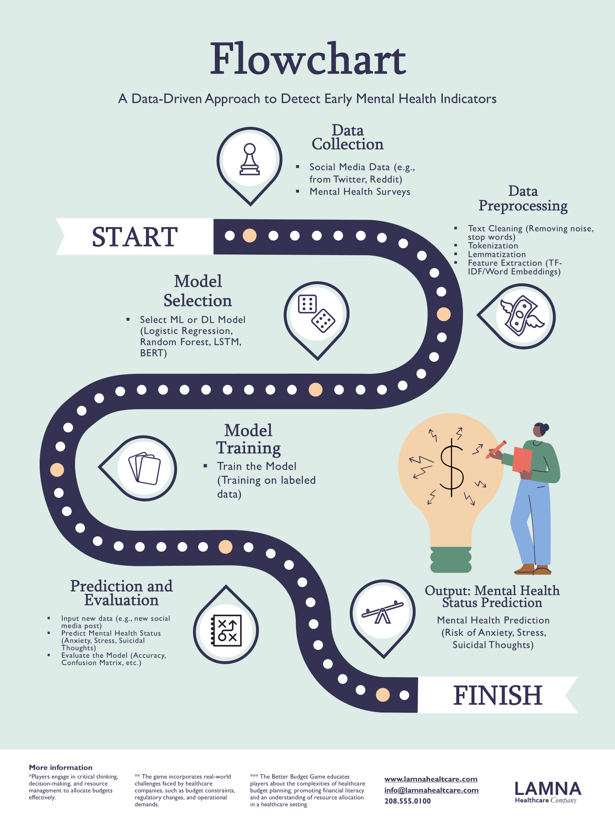

Slide 6


Algorithm Used and Code
Preprocessing Algorithms
Natural Language Processing (NLP)
Text Cleaning & Tokenization
Lemmatization
TF-IDF (Term Frequency-Inverse Document Frequency)
Sentiment Analysis
Feature Engineering
N-grams
Word Embeddings (Word2Vec/GloVe)
Prediction Model Algorithms
Machine Learning Models
Logistic Regression
Random Forest
Deep Learning Models
LSTM (Long Short-Term Memory Networks)
BERT (Bidirectional Encoder Representations from Transformers)

Slide 7
Future Scope / Conclusion
Future Scope:
Discuss potential improvements like:
Enhancing accuracy with more data
Integrating with mental health care platforms
Including additional data sources
Conclusion:
Summarize the project's significance and its potential to make a difference in mental health awareness.

Slide 8
Thank you
GitHub repository:
https://github.com/PCSEAIML-25/MP13-Unveiling-Mental-Health-Signal

